Slide 1

Swami Keshvanand Institute of Technology, Management & Gramothan, Jaipur
Department of Computer Science and Engineering
Industrial Training Presentation
on
BUILDING PERSONAL PORTFOLIO WEBSITE
Submitted to:
Faculty Name : Mr. Vinod Kataria
Assistant Professor, CSE Department
Presented By:
Student Name :Parineeta Sharma
Reg. No.: 23ESKCX078
Semester and Year: 3RD sem
Session: 2024-25

Slide 2

Building a Personal Portfolio website

Slide 3
Index
1
2
3
4
5
Introduction
Purpose &
Objective
Of project
Technology
overview
Methodology
&
Project
Screenshots
Future Work

Slide 4
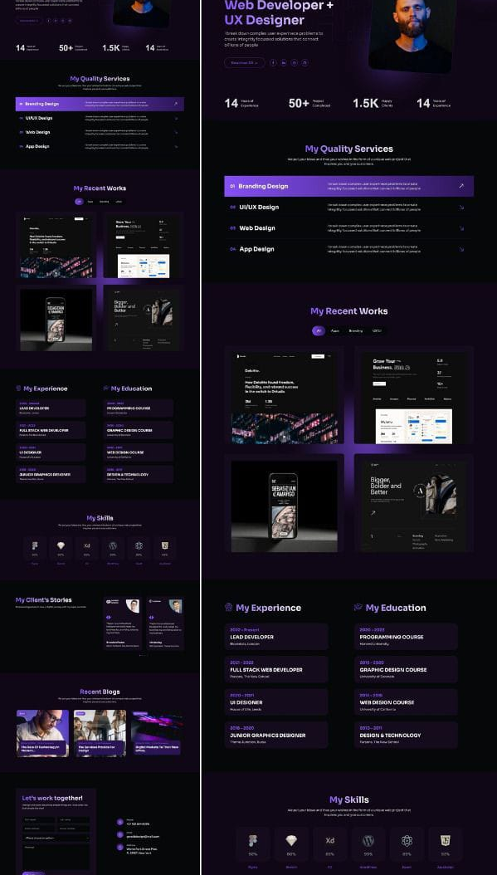
Introduction
Since everything is being digitalized so one of the most effective of presenting yourself is through your Personal Portfolio Website. Hence, this project/website aims to provide users a with a simple and efficient platform to create professional resumes . By leveraging technologies like HTML,CSS, PHP.

Slide 5

Purpose & Objective of the project

Slide 6
OBJECTIVES..
My Web project is dynamic portfolio website the provide users a overview of how they can build their own personal portfolio by providing them with and example of my own personal portfolio website .
By simply submitting their details user can generate a polished , well-structured resume in a matter of minutes .
The platform is tailored for efficiency , ensuring that individuals looking to present their qualifications and experience can do so quickly , without compromising in quality.
the user centric approach makes it an ideal tool for job seekers ,students and professionals aiming to present their credentials in a concise and professional format..

Slide 7
Business opportunities are like buses. There’s always another one coming.
“
”
Richard Branson

Slide 8
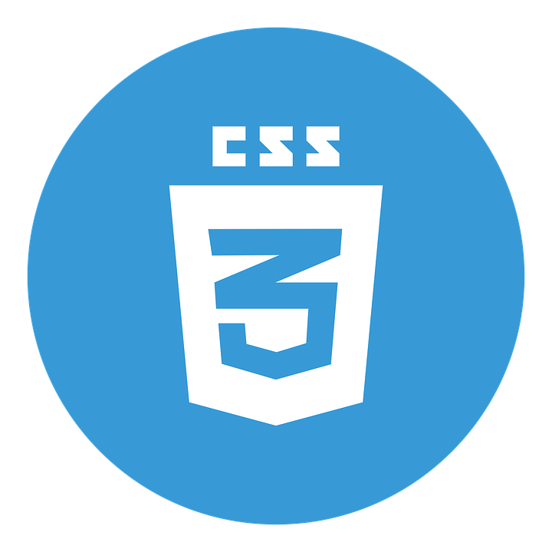



Technologies Used
CSS (Cascading Style Sheets) is used to style and layout web pages — for example, to alter the font, color, size, and spacing of your content, split it into multiple columns, or add animations and other decorative features
HTML is a markup language that tells web browsers how to display content on a page, including text, images, and other media
PHP is a server-side scripting language that's used to create web pages, applications, and services.
JavaScript is a programming language that is used in web development to create dynamic, responsive, and user-friendly web applications.

Slide 9
Methodology​
Plan the Structure and Design
Home: Brief introduction and navigation.
About: Your bio, expertise, skills.
Portfolio: Showcase your work (projects, case studies, clients).
Contact: A form for users to reach out to you.
Portfolio Creator: A form where users input their own information and generate a custom portfolio.
Design Layout:
.Create a clean, responsive design using CSS frameworks like Bootstrap or writing custom CSS.
​ ​
Build the basic structure using HTML
First we create a basic html file named index.html.
which will include all the html and
js related to the web page.
Style the website using CSS
Creating style.css for the styles
Define font families ,colors ,spacing , layouts .
It also helps in layout alignment and responsiveness.
​
Then in the create section of the website user can submit there information that he wants to include in his portfolio . The information will be stored in database . And the future work includes processing this information into a well structured portfolio website

Slide 10
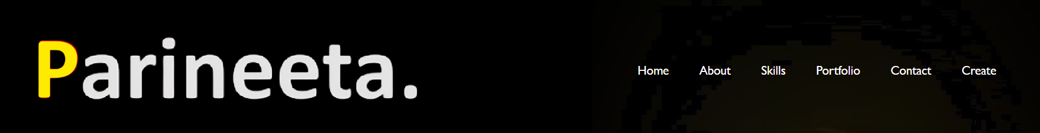
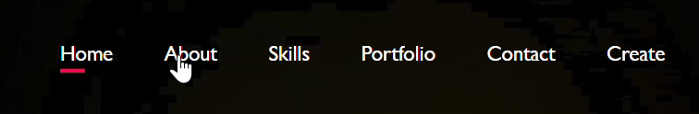
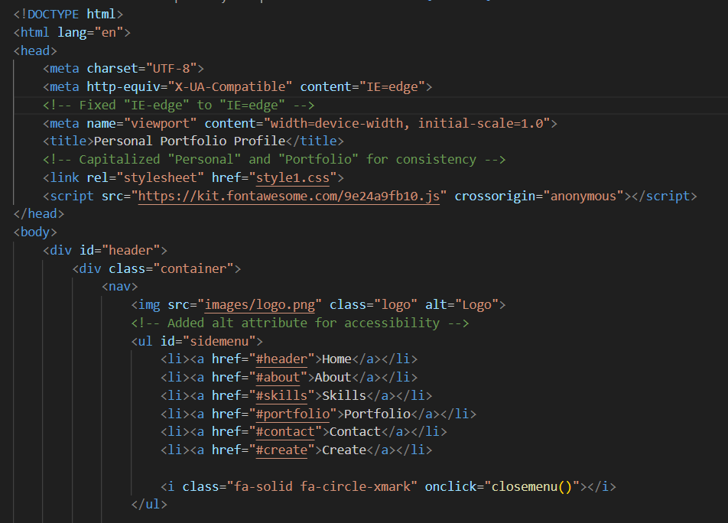
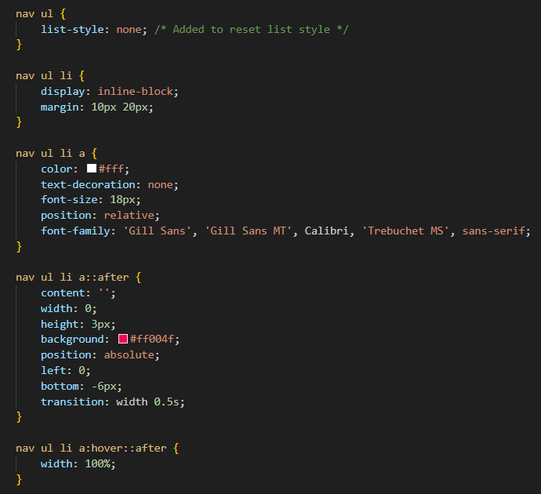
Project Screenshots​
HOVER EFFECT

Slide 11
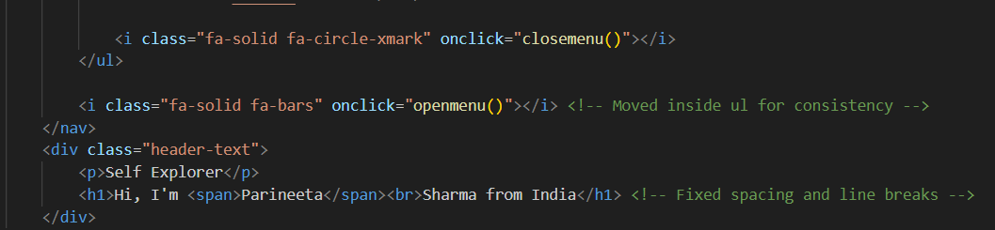
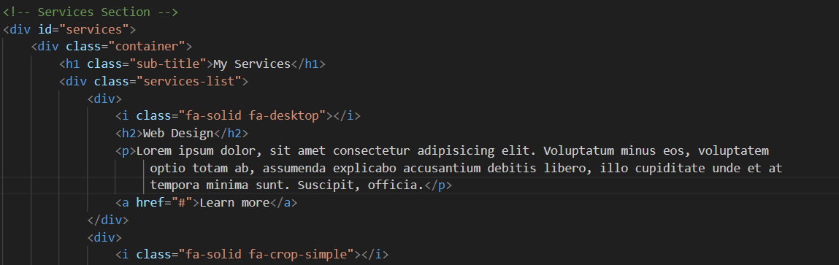
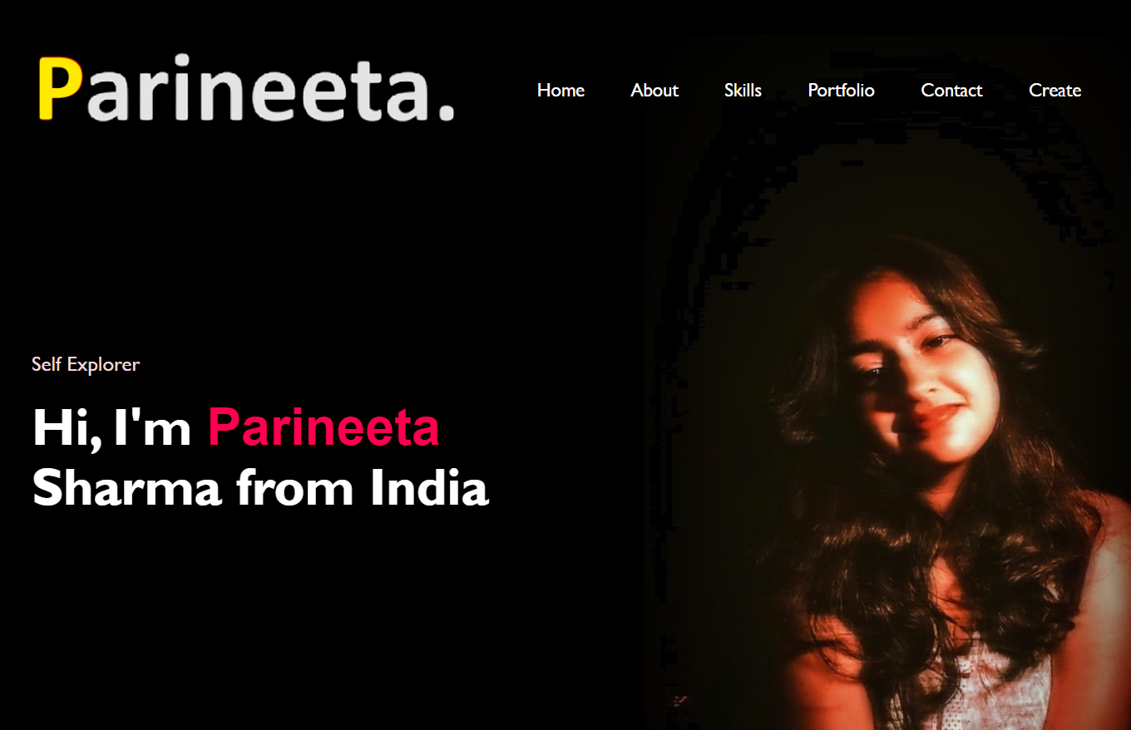
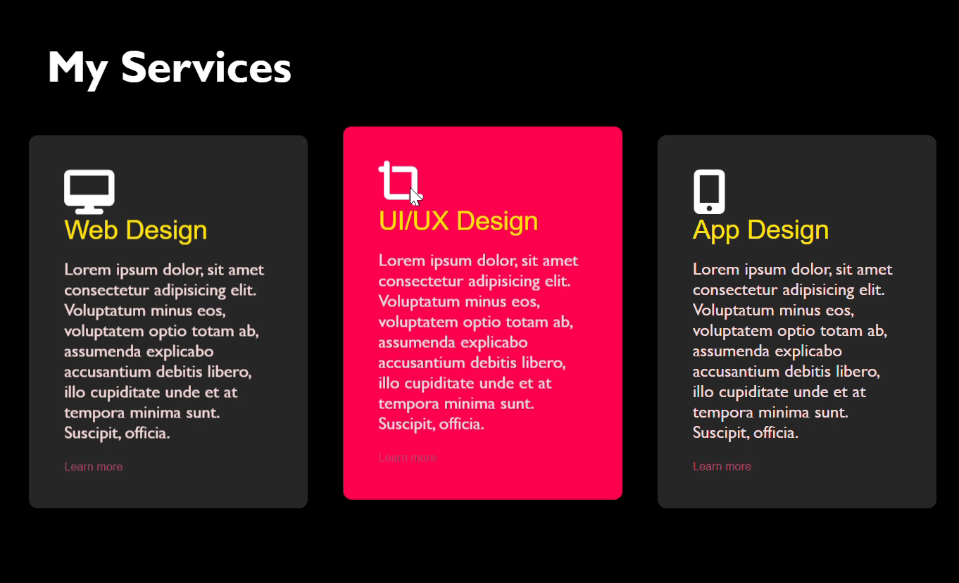
HOME PAGE
SKILLS PAGE
MY SKILLS

Slide 12

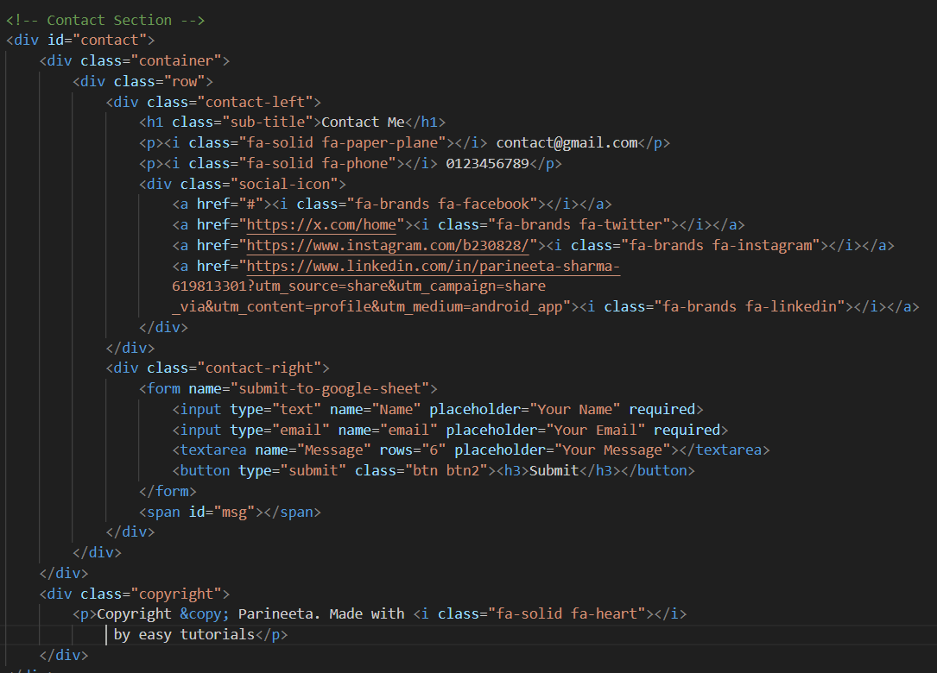
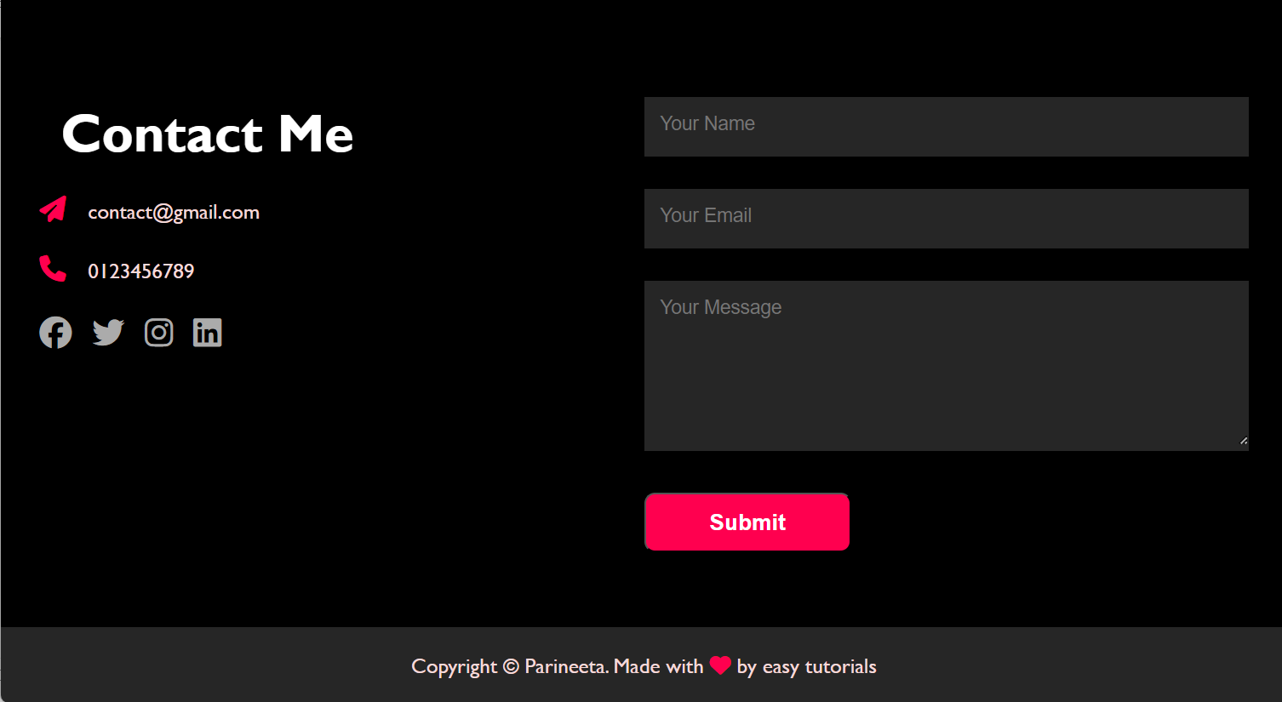
The social icons have a hover effect too
and are responsive .
This page has a review section , so that people can drop there valuable feedback and needs

Slide 13

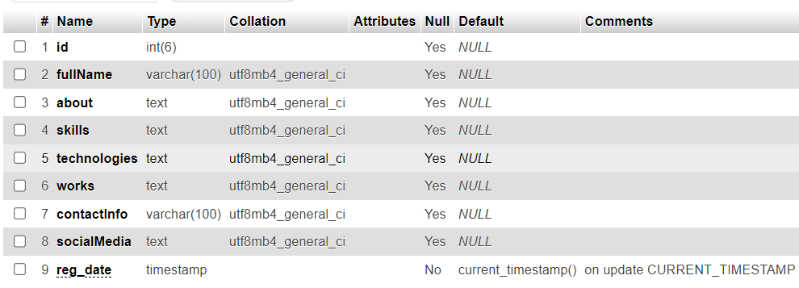
The data is entered in the form created by PHP the data taken as input from the user is stored in server . This stored data is used to create the personal portfolio of the user . The creation of the portfolio is part of future work , rest the input is taken and saved .

Slide 14





FUTURE WORK
Giving users accessibility to modification and editing.
Adding templates so that user can choose the interface.
Allow users to save and access their resumes online via cloud services like Google Drive or Dropbox.
Implement user accounts to enable users to save and edit their resumes at any time.
Enable real-time collaboration for users to receive feedback or make edits with others.

Slide 15



Our platform is designed to empower individuals by offering a dynamic space to showcase their professional journey. Whether you're looking to build your personal portfolio or create one for others, we provide the tools to craft a customized, visually appealing representation of your skills and accomplishments. With an intuitive interface, users can easily create and manage their portfolios, ensuring they can highlight their strengths and milestones in a way that stands out. Start building your personal brand with us today and share your unique story with the world.

Slide 16

Thank you

